Slide 1
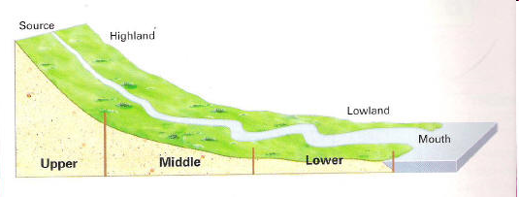
RIVERS Revision ;
Upper/middle and lower course features
LO: To know how to recognise main river features and describe how they are formed.

Slide 2
TASK: Each group of 4 will have half and hour to organise a presentation to the rest of the class to explain how ONE river feature is formed:
V-shaped valley
Delta
Waterfall
Meander/migration
Oxbow lake
Rapids levees
You must include How to recognise your feature, whether it is found in upper/lower or middle courses, and explain how they are formed (erosion or deposition?)

Slide 3
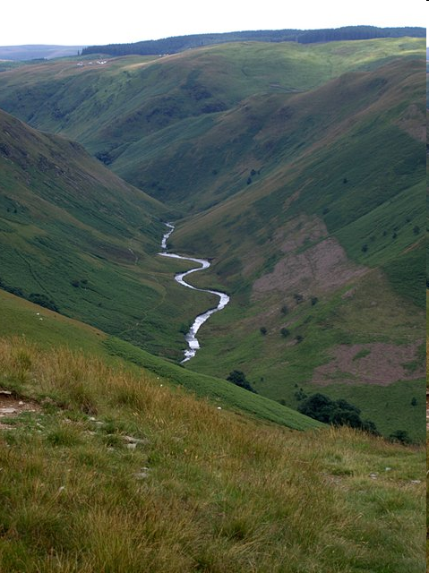
V Shaped Valley

Slide 4
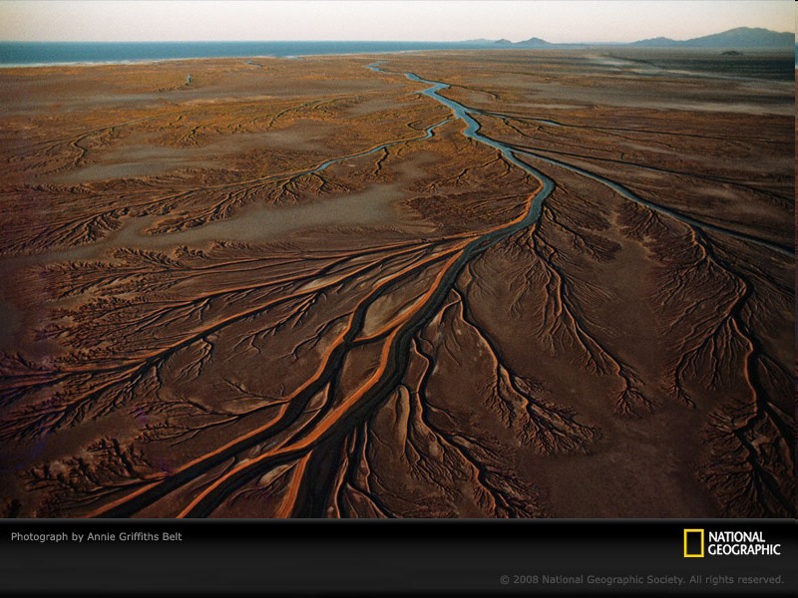
River Delta

Slide 5
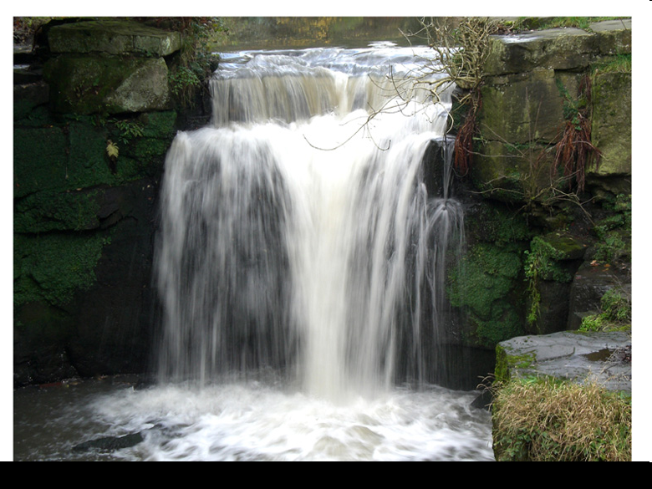
Waterfall

Slide 6
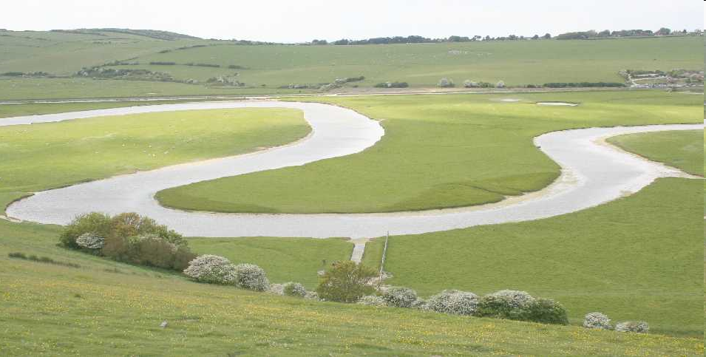
Meander

Slide 7
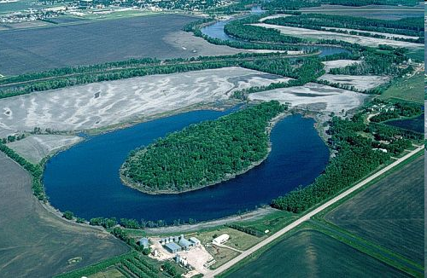
Oxbow lake

Slide 8
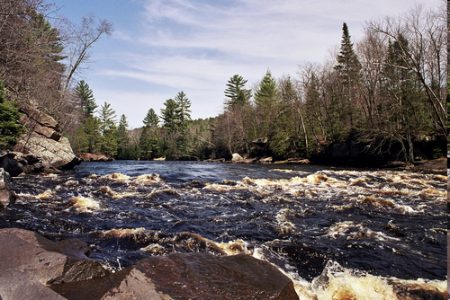
Rapids

Slide 9
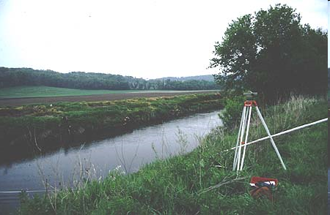
Natural levees

Slide 10
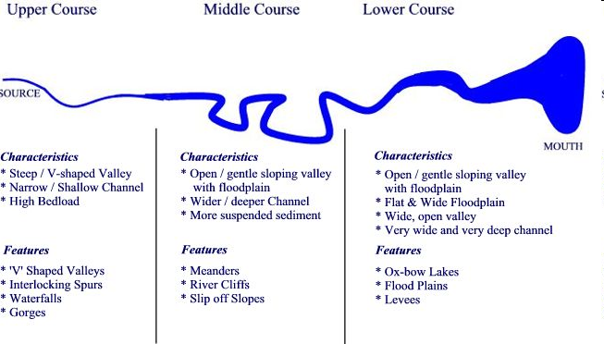
Where do we find them?

Slide 11
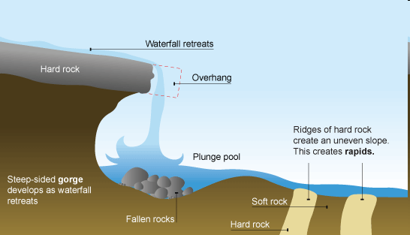
Rapids
Rapids are stretches of fast-flowing water tumbling over a rocky-shallow riverbed. They are caused by different resistance among various rock. They are formed when the water goes from one hard rock that resists the water's erosion to a softer rock that is easier eroded. The rocks break up the flow of the flow, but are not big enough to form a waterfall. Over time, rapids are formed.
Rapids occur in a fast-moving stream littered with large, hard rock formations.
Water erodes soft land faster than hard, so the rocks remain standing as incomplete barriers. The stream’s fast-moving water rushes around the rocks, often foaming into “white water.”

Slide 12
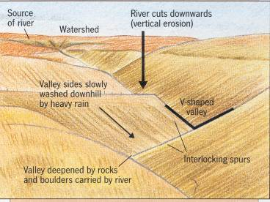
The river erodes vertically at a greater
rate than it does horizontally deepening
the valley.
The river continues to erode vertically,
the river banks become less stable and after
A period of heavy rain, due to gravity they
collapse.
This creates a v-shaped valley.
The process is repeated, deepening
The valley further.
As the river flows through the valley it is forced to swing from side to side around more resistant rock outcrops (spurs). As there is little energy for lateral erosion, the river continues to cut down vertically flowing between spurs of higher land creating interlocking spurs.
V-shaped Valley

Slide 13
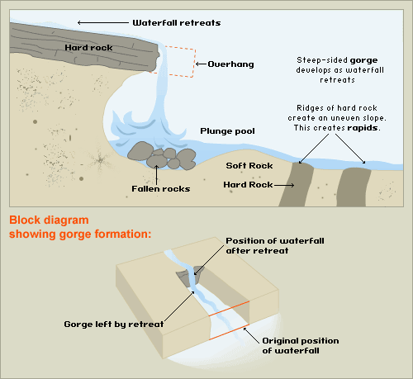
Waterfall
Waterfall
Many waterfalls form when rivers meet a band of softer less resistant rock after flowing over a relatively hard resistant rock. The softer rock is worn away more quickly, and the harder rock undercut.
The overhead hard rock forms an overhang, which will eventually collapse, to form a deep plunge pool.
This process is repeated causing the waterfall to retreat upstream creating a gorge in its wake.

Slide 14
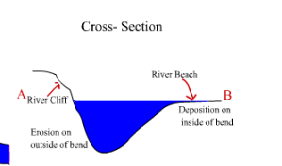
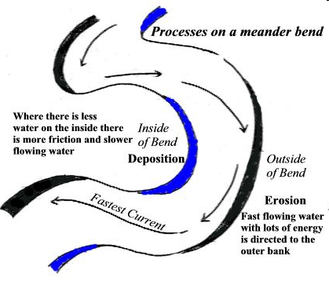
meanders
Within sections of the river channel, the flow tends to wind from side to side through a pattern of deep pools and shallower riffles. Riffles are formed by bed load deposits.
A meander forms when the river channel bends, most of the water is directed to the outside of the bend. This reduces friction and increases the speed of the river at this point. The river therefore has more energy to transport through suspension, which will lead to erosion of the outside bank by corrasion. The bank will be undercut, collapse and retreat to leave a small river cliff.
Meanwhile, there is less water on the inside of the bend, there is an increase in friction and a decrease in velocity. As the river loses energy, it deposits some of its load to form a slip off slope.
Meander

Slide 15
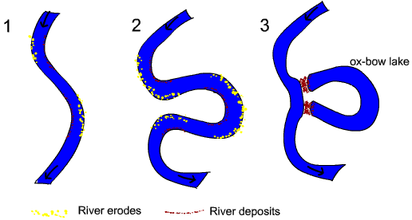
Following on from the development of a meander…..
Continued erosion (corrasion) on the outside of the bend results in the neck of the meander getting narrower until, usually at a time of flood, the river cuts across. The fastest current will now be flowing in the centre of the channel and deposition is now next to the banks. The original meander is blocked off to leave a crescent shaped Ox-Bow Lake.
Ox-Bow lake

Slide 16
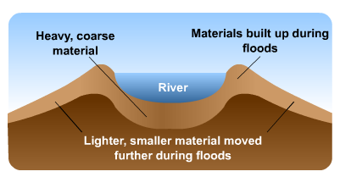
Levee
Floodplain and levee
In the lower course the river widens its valley through lateral erosion. At times of high discharge the river has considerable amounts of energy, which it uses to transport material through suspension.
When the river overflows its banks, it will spread out over the surrounding area which is flat. This sudden increase in friction will reduce the velocity of the river causing it to deposit its load (silt). Each time the river floods another layer of silt is added creating as flat floodplain.
The coarsest material will be dropped first, and this can form a natural embankment, called a Levee next to the river. Levees can help to prevent further flooding.
natural levee
–noun
a deposit of sand or mud built up along, and sloping away from, either side of the flood plain of a river or stream.

Slide 17
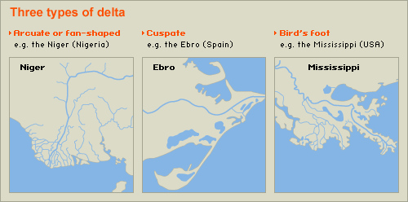
Delta
Accumulation of silt deposited on the seabed at the month of the river. Because the river’s velocity is much reduced when it joins the sea, it must deposit its load. If the load is built up above sea level then mud banks form to create a delta.
Deltas only form under certain conditions:
The river must be transporting a large amount of sediment
The sea must have a small tidal range and weak currents
The sea must be shallow at the river mouth
Deltas are found at the mouth of large rivers - for example, the Mississippi. A delta is formed when the river deposits its material faster than the sea can remove it. There are three main types of delta, named after the shape they create (see above):

